Slide 1
Do your homework for good marriage communication ……..OR
Roll the dice and chance it
Watch a quick YouTube video
Invest the time to understand

Slide 2
Language used at nearly every wedding ceremony and union represented here…..
Love him/her – I Cor. 13:4 - Charity suffereth long, and is kind; charity envieth not; charity vaunteth not itself, is not puffed up, 5 Doth not behave itself unseemly, seeketh not her own, is not easily provoked, thinketh no evil; 6 Rejoiceth not in iniquity, but rejoiceth in the truth; 7 Beareth all things, believeth all things, hopeth all things, endureth all things
To Honor her/him - Exodus 20:12 Honor thy father and thy mother; that thy days may be long upon the land which the Lord thy God giveth thee.
Cherish her/him - Ephesians 5:29 For no man ever yet hated his own flesh; but nourisheth and cherisheth it, even as the Lord the church;

Slide 3
Available Resources
Holy Word of God is like an instruction book on how husbands are to love our wives.
Modern writers have uncovered a number of key truths relative to our need to actively pursue a better understanding of each other and how we communicate
Saving your marriage before it starts – Les and Leslie Parrot
Tender Warrior – Stu Weber
5 Love Languages – By Gary Chapman
Words of affirmation
Acts of service
Receiving gifts
Quality time
Physical Touch

Slide 4
New Challenges when you blend 40+ years of experiences into one home.
Seek first to understand then be understood – Franklin Covey
This denotes empathetic listening
There is a flashpoint, where your values and the values of your wife collide.
Loving your husband or wife is great but it is not enough. Study to show thyself approved……..
Men, be the provisionary God created you to be
When you do disagree: FIGHT FAIR

Slide 5
Learning to speak female…. Requires a life-long commitment
Women do Not always want you to solve their problems. Try these rules to improve your communication
Hearing is passive communication
Listening is active communication
Warmth
Genuineness
Empathy
Apologize when necessary
https://vimeo.com/66753575
Let’s talk about the female side first and then the poor feller who is fighting back his natural inclination.

Slide 6
We cannot, not communicate
Non-verbal communication is 58%
Tone of voice is 35%
Words are 7%
God.’s word is full of examples of how we are to approach our lives together as husband and wife.
Ephesians 4:29
James 1:19 ; 1 Peter 3
Intro: Duty of wives and husbands -- Unity and love enjoined.
Please don’t allow yourself to have a foolish marriage.
Titus 3:3 For we ourselves also were sometimes foolish, disobedient, deceived, serving divers lusts and pleasures, living in malice and envy, hateful, and hating one another.
1 Likewise, ye wives, be in subjection to your own husbands; that, if any obey not the word, they also may without the word be won by the conduct of the wives; 2 While they behold your chaste conduct coupled with fear.

Slide 7
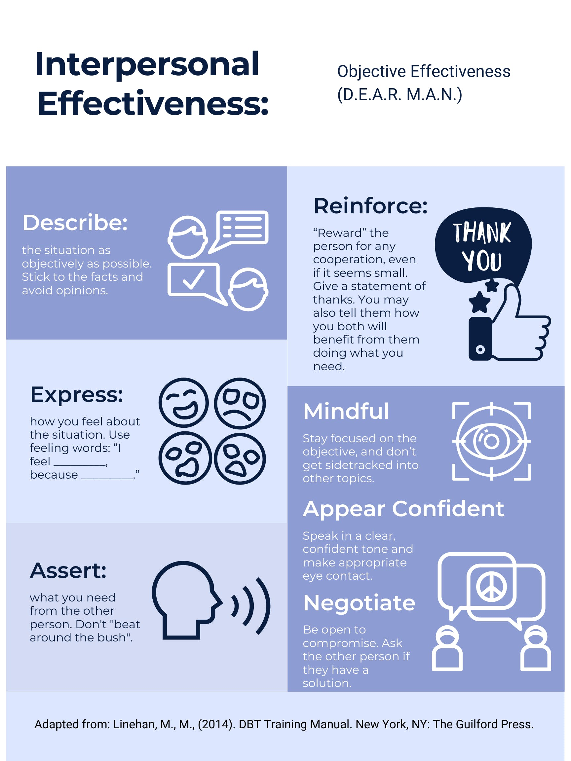
An effective reminder when communicating

